Slide 1

Cerebral Stroke Prediction
Leveraging Data to Identify Risk Factors and Improve Patient Outcomes

Slide 2
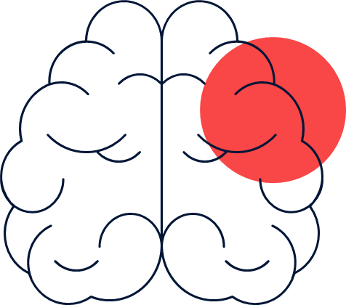
What is Cerebral Stroke?
Stroke is a critical medical condition characterized by the sudden loss of blood supply to a part of the brain, leading to impairment in the function of the body controlled by the affected brain region. It is a significant cause of mortality and long-term disability worldwide.
Early detection and timely intervention are crucial for preventing severe consequences associated with strokes.

Slide 3
About dataset
The cerebral Stroke dataset is a valuable resource for studying the factors contributing to strokes and developing predictive models for early detection. This dataset comprises 12 features, including demographic, lifestyle, and medical history variables, along with the target column indicating the occurrence of a stroke. However, the target column is imbalanced, posing a challenge for accurate prediction.

Slide 4

Project Overview:
This project utilizes a Cerebral Stroke dataset with imbalanced classes to explore stroke predictors, handle class imbalance, engineer features, and build predictive models for early detection. Through data analysis and machine learning techniques, it aims to uncover factors influencing strokes and develop actionable insights for risk assessment and intervention strategies, ultimately contributing to stroke prevention and management.

Slide 5

Data Preprocessing
Encoding categorical variables.
Replacing missing values in BMI column.
Handling missing values.
Dropping unnecessary columns.
Importing necessary libraries and loading the dataset

Slide 6

Model Training and Evaluation:
Classification Model:
The KNN classifier is applied to predict stroke risk based on the dataset features.
Resampling Techniques
Random Oversampling:Implemented using RandomOverSampler from the imbalanced-learn library to balance the dataset by generating synthetic samples for the minority class.
Random Undersampling: Implemented using RandomUnderSampler from the imbalanced-learn library to balance the dataset by removing some samples from the majority class.
Logistic Regression.
A logistic regression model is implemented from scratch, including methods for fitting the model to the data, making predictions, and evaluating model performance using accuracy, precision, recall, F1 score, and confusion matrices

Slide 7

Model Training and Evaluation:
Model Evaluation:
Accuracy Score: Calculated using accuracy_score from scikit-learn to evaluate the performance of the KNN models.
Confusion Matrix: Generated using confusion_matrix from scikit-learn to visualize the performance of the models.

Slide 8
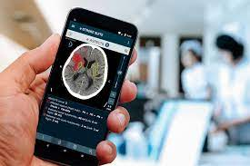
GUI for Stroke Prediction:
Tkinter GUI: A graphical user interface (GUI) is created using Tkinter, allowing users to input age, BMI, and smoking status to predict stroke risk. However, the actual prediction logic is a simple mock based on predefined conditions

Slide 9
In conclusion
addressing imbalanced datasets in stroke risk prediction is crucial for accurate modeling. Through techniques like under-sampling and over-sampling, we achieved improved model performance. However, these methods come with trade-offs such as information loss or overfitting. By combining resampling techniques with algorithmic advancements, we can enhance predictive accuracy and enable more precise healthcare interventions. This underscores the importance of ongoing research and innovation in data science for better healthcare outcomes

Slide 10

Tank you
Team members
Hajar Rashad Deraz
Nader Mohammed
Mohammed Salem

